Slide 1



Servicios Ciudadanos
Servicios Ciudadanos
División
Sistemas y Tecnologías
de la Información

Slide 2

3
Servicios Ciudadanos
Printers, Multifunction, plotters and scanners devices
División
Sistemas y Tecnologías
de la Información

Slide 3
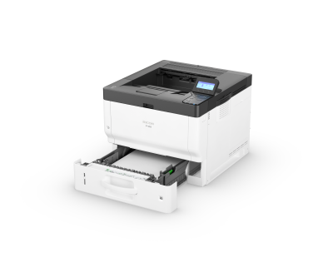
Servicios Ciudadanos
FCC Infrastructure & Comms Services
Printers Laser B&W
 | Ricoh P501 Print speed, black Up to 43ppm Monthly duty cycle Up to 150,000 pages Processor speed 1200 MHz Memory, standard 512 MB Size: 370 x 392 x 306 mm Weight 14 Kg Printing Format A4 https://www.ricoh.es/productos/impresora-oficina/impresoras-monofuncionales/p501/
Laser B&W – Medium A4
RU: Laser B&W – Medium
División Sistemas y Tecnologías de la Información

Slide 4
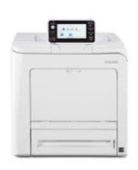
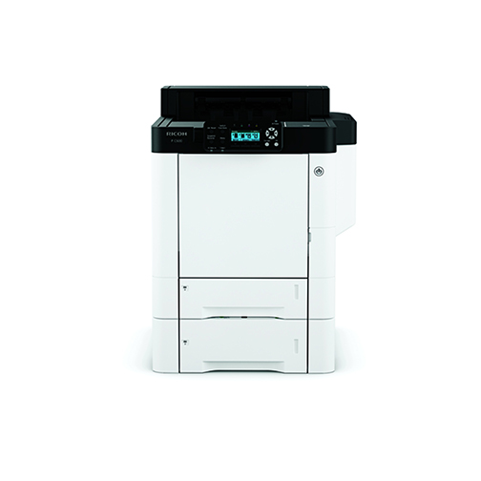
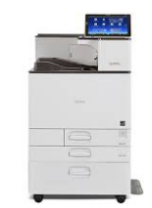
Servicios Ciudadanos
FCC Infrastructure & Comms Services
 | Ricoh SP C352DN Print speed, black/color Up to 30 ppm Monthly duty cycle Up to 75,000 pages Processor speed 1460 MHz Memory, standard 2 Gb MB Size: 400 x 480 x 404 mm Weight 29 Kg Printing Format A4 https://www.ricoh.es/productos/impresora-oficina/impresoras-monofuncionales/sp-c352dn Ricoh PC 600 Print speed, black /color Up to 40 ppm Monthly duty cycle Up to 150,000 pages Processor speed 533 MHz Memory, standard 1 GB Size: 444 x 658 x 490 mm Weight 57 Kg Printing Format A4 https://www.ricoh.es/productos/impresora-oficina/impresoras-monofuncionales/p-c600/ Ricoh SP C840DN Print speed, black /color Up to 45 ppm Monthly duty cycle Up to 200,000 pages Processor speed 1750 MHz Memory, standard 2 GB Size: 587 x 685 x 864 mm Weight 85Kg Printing Format A3 A4 https://www.ricoh.es/productos/impresora-oficina/impresoras-monofuncionales/sp-c840dn/
Laser Color – Low / Personal A4
RU: Laser Color – Low
Printers Laser Color
Laser Color – Medium A4
RU: Laser Color – Medium
Laser Color – High A3
RU: Laser Color – High
División Sistemas y Tecnologías de la Información

Slide 5
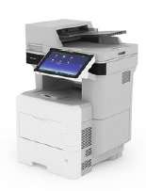
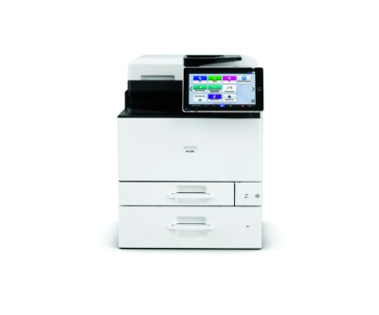
Servicios Ciudadanos
FCC Infrastructure & Comms Services
Printers Multifunction Devices
 | Ricoh IM 550F Print speed, black Up to 55 ppm Monthly duty cycle Up to 250,000 pages Processor speed 1,36 GHz Memory, standard 2 Gb Analogue Fax Included Size 480 x 539 x 644 mm Weight 28 kg Printing Format A4 https://www.ricoh.es/productos/impresora-oficina/impresora-multifuncional/im-550f/ Ricoh IMC300F Print speed, black Up to 30 ppm Monthly duty cycle Up to 20,00 pages Processor speed 1460 MHz Memory, standard 2 Gb Size 498 x 585 x 510 mm Weight 46 kg Printing Format A4 https://www.ricoh.es/productos/impresora-oficina/impresora-multifuncional/im-c300f/
Multifunction – Low A4
RU: Multifunction B&W – Low
Multifunction – Low A4
RU: Multifunction Color – Low
División Sistemas y Tecnologías de la Información

Slide 6

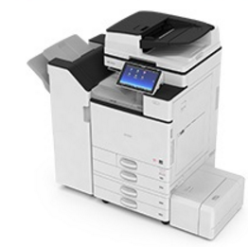
Servicios Ciudadanos
FCC Infrastructure & Comms Services
 | Printers Multifunction Devices Ricoh IMC3500 Print speed, black/color Up to 35 ppm Monthly duty cycle Up to 80,000 pages Processor speed 1460 MHz Memory, standard 2 Gb Paper Trays 2 Size 587 x 685 x 963 mm Weight 101,3 Kg Printing Format A3 A4 https://www.ricoh.es/productos/impresora-oficina/impresora-multifuncional/im-c3500/ Ricoh IMC 5500 Print speed, black Up to 55 ppm Monthly duty cycle Up to 200,000 pages Processor speed 1460 MHz Memory, standard 2 Gb Paper Trays 4 Size 587 x 685 x 963 mm Weight 101,5 kg Printing Format A3 A4 https://www.ricoh.es/productos/impresora-oficina/impresora-multifuncional/im-c5500/
Multifunction – Medium A3
RU: Multifunction Color – Medium
Multifunction – High A3
RU: Multifunction Colour – High
División Sistemas y Tecnologías de la Información

Slide 7
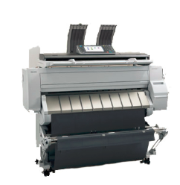
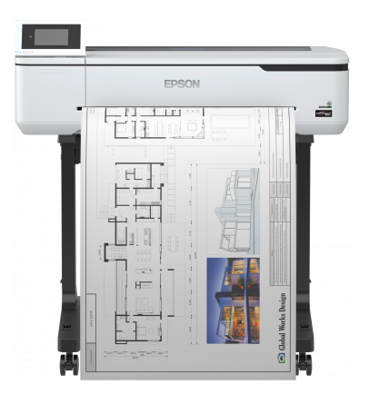
Servicios Ciudadanos
FCC Infrastructure & Comms Services
 | Plotter Devices MP CW2201SP Print speed 3,8 ppm (A1 horizontal) mono Scan speed B/W: 600 dpi: 80 mm/s, 200 dpi: 160 mm/s Color: 600 dpi: 26,7 mm/s, 200 dpi:40 mm/ Processor speed 1,75 GHz Paper tray include 1 Size 1.384 x 660 x 1.214 mm Weight 120 Kg Printing Format Maxime: 914,4 x 15.000 mm https://www.ricoh.es/productos/impresoras-de-produccion/impresoras-gran-formato/mp-cs2201sp.html Epson SURECOLOR T3100 Print speed Mono. 34 sec Color 34 sec first page Memory 1 Gb Paper tray include 1 Size 970‎ x 696 x 913 mm Weight 38 Kg Printing Format A1, A2, A2+, A3+, A3, A4, B1, B2, B3, B4, B5, 17 ", 24 " https://www.epson.es/products/printers/large-format-printers/surecolor-sc-t3100-series
Plotter Mutifunction Medium&high
RU: Plotter Color – Medium& high
Plotter –Low A1
RU: Plotter Color – Low
División Sistemas y Tecnologías de la Información

